Slide 1



NO LIMIT LIVING
X
DATA MINE
07/11/2024
© 2024 NO LIMIT LIVING, LLC. ALL RIGHTS RESERVED.

Slide 2

CONTENT
01
Introduction
02
Fall 2024
03
Demo
04
Spring 2025
05
Conclusion
06
Acknowledgements

Slide 3
Dataset link
https://www.ngdc.noaa.gov/hazard/hazards.shtml

Slide 4
01 - Introduction
Company’s Background
No Limit Living, LLC is a real estate investment firm that focuses on acquiring, rehabilitating, renting, and selling residential properties.

Slide 5
Problem Statement
This project analyzes historical disaster data to identify trends, risk factors, and vulnerable areas. The goal is to provide insights that can improve preparedness and resilience against future disasters.

Slide 6
Project Goal
The goal of this project is to analyze patterns and relationships in the dataset, and generate actionable insights. This includes identifying key trends, understanding correlations.

Slide 7
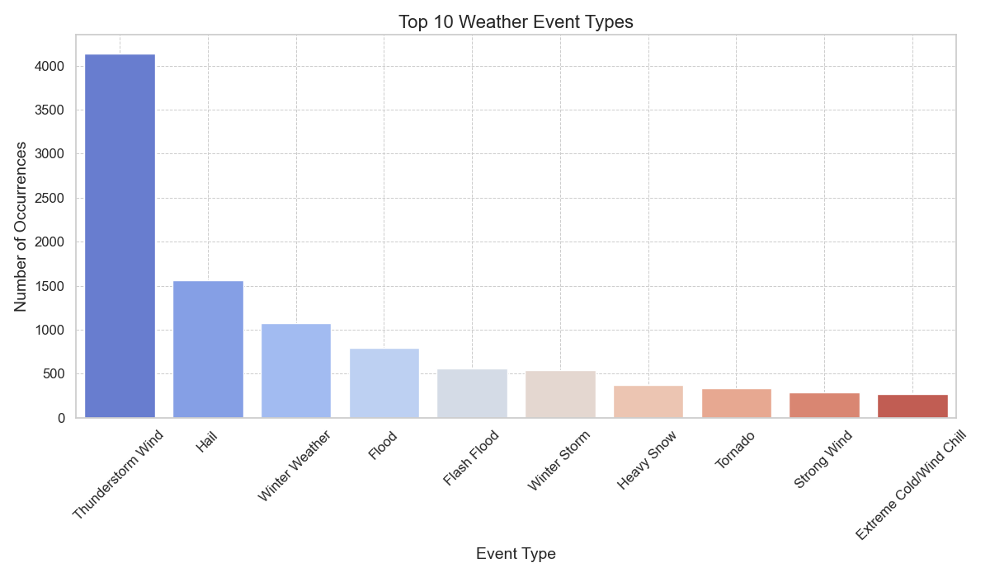
To start, we will examine the distribution of different weather event types in the dataset. This initial analysis will help us understand which events are the most frequent.

Slide 8
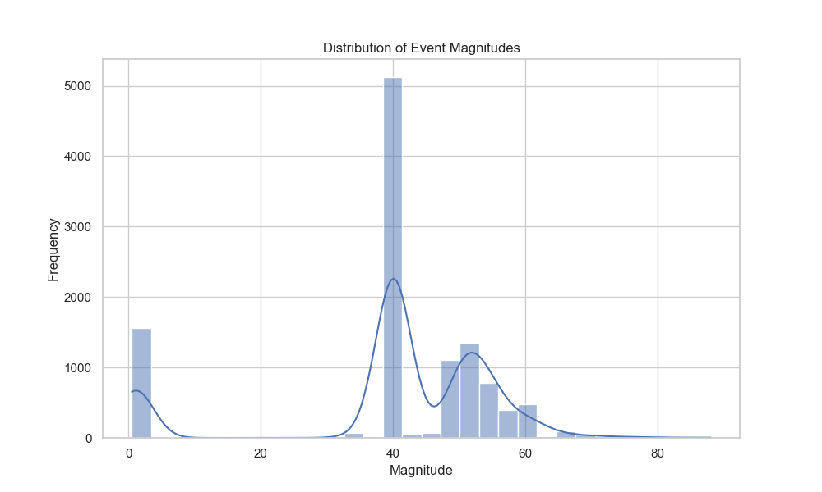
Distribution of Event Magnitudes
In this part, we'll analyze the magnitude of the events and examine their potential impact, such as the number of injuries and deaths (both direct and indirect). This will give us insights into which event types are not only frequent but also severe.

Slide 9
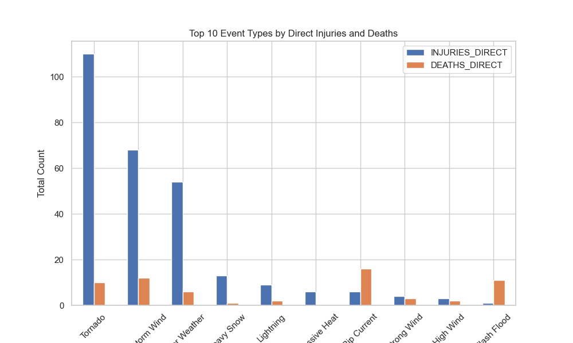
Event Types by Direct Injuries and Deaths

Slide 10
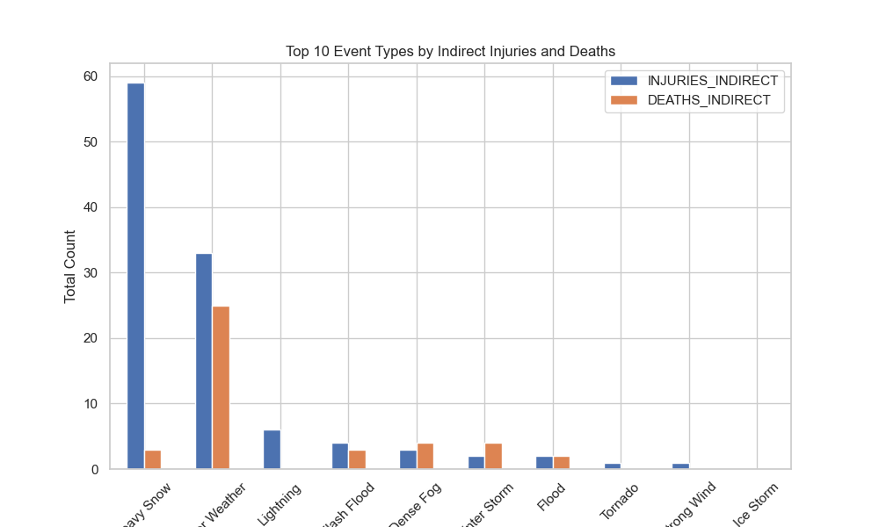
Event Types by Indirect Injuries and Deaths

Slide 11
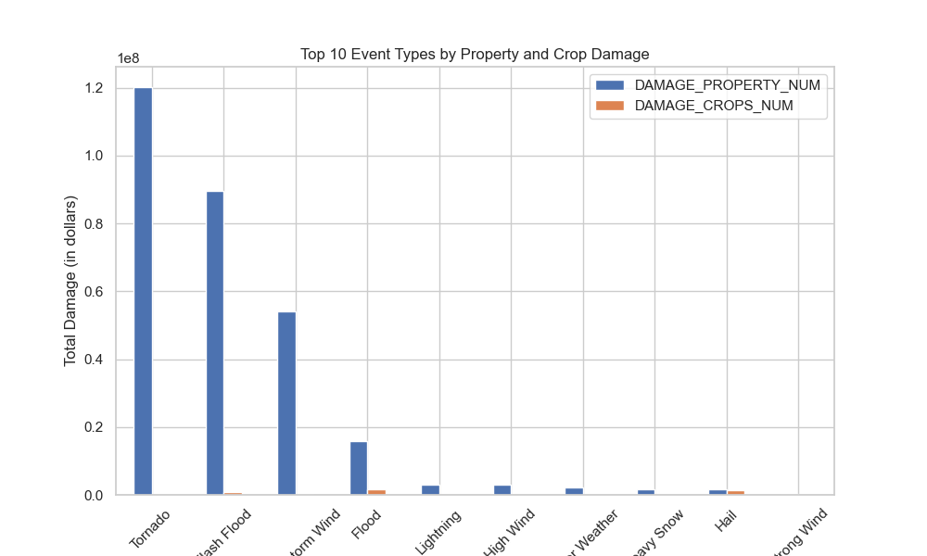
Property and Crop Damage

Slide 12
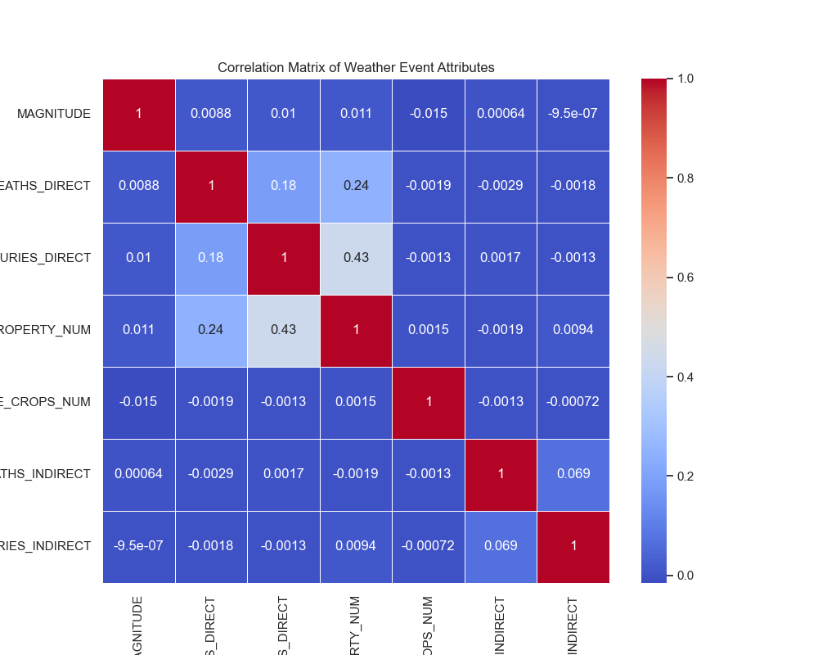
Correlation Between Events
The strong correlation between direct injuries and property damage can help focus attention on events where human safety and economic loss are both major concerns. These are likely to be the events we should prioritize for early warning systems and disaster preparedness.
The lack of correlation with magnitude is an interesting finding. This suggests that focusing on event magnitude alone may not be sufficient to predict its impact.
© 2024 NO LIMIT LIVING, LLC. ALL RIGHTS RESERVED.
Notes:
Frontend

Slide 13

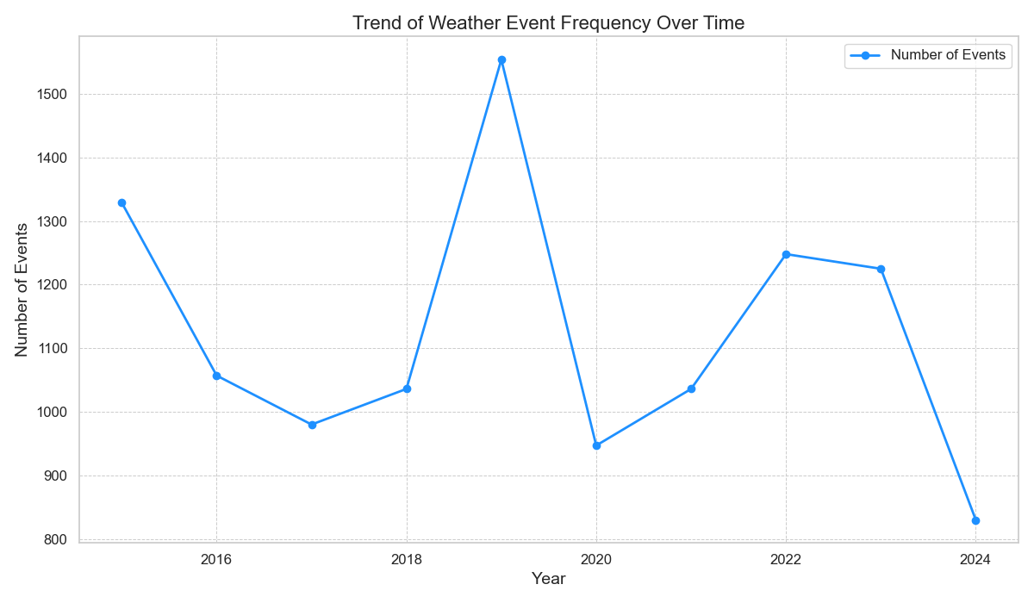

In this section, we will perform a time series analysis to understand how the frequency and impact of weather events have changed over time. This will help us identify trends, such as whether certain types of events have become more frequent or if their impact has increased over time.
© 2024 NO LIMIT LIVING, LLC. ALL RIGHTS RESERVED.

Slide 14
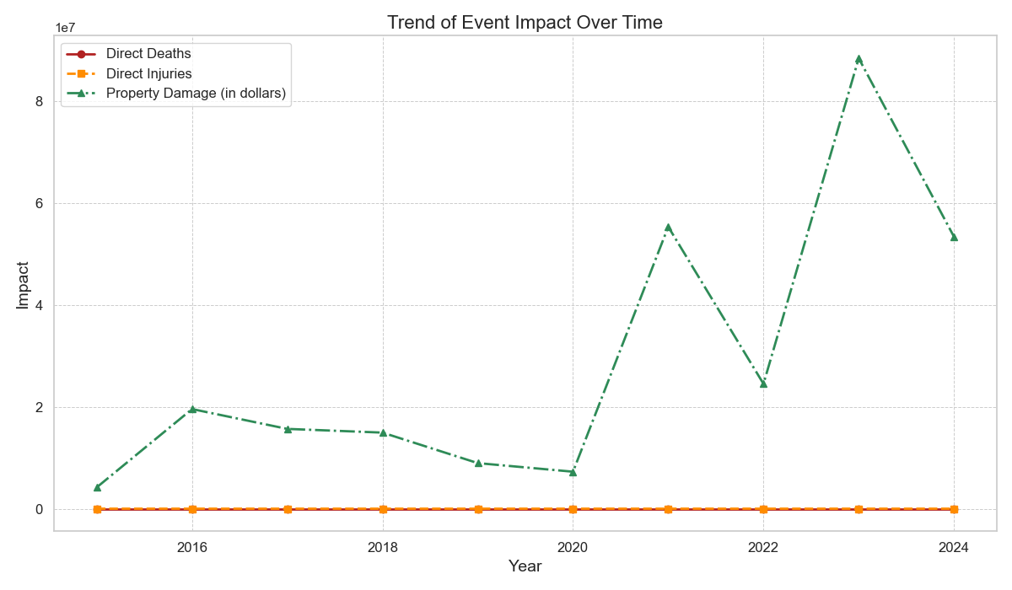
© 2024 NO LIMIT LIVING, LLC. ALL RIGHTS RESERVED.

Slide 15
Conclusion
Event Frequency: The number of weather events fluctuates over time, with notable peaks in 2019 and 2022. These variations might be influenced by external factors such as climatic conditions, changes in data collection methods, or the occurrence of major weather events in specific years.
Impact on Property and Human Life:
Tornadoes, flash floods, and thunderstorm winds are among the most frequent and destructive event types, causing significant property damage.
Despite a relatively stable trend in direct injuries and deaths, economic losses due to weather events have surged, particularly in 2021 and 2023. This points to the growing financial impact of weather disasters, which may be driven by factors such as urbanization and more expensive infrastructure.
Correlation Insights:
The analysis reveals a strong correlation between direct injuries and property damage, highlighting that severe weather events can simultaneously threaten human safety and cause extensive infrastructure damage.
Interestingly, the magnitude of weather events (e.g., wind speed or hail size) did not show a strong correlation with the number of injuries or property damage, suggesting that other contextual factors such as preparedness and geography may play a role in mitigating the impact.
© 2024 NO LIMIT LIVING, LLC. ALL RIGHTS RESERVED.

Slide 16
06 - Acknowledgements and Thanks
Emmani Ellis
Sharan Sivakumar
Thanmaya Pattanashetty
Nicholas Lenfestey
Abhinav Chowdary

Slide 17
References
Python Tutorial :https://www.youtube.com/watch?v=7wnove7K-ZQ&list=PLu0W_9lII9agwh1XjRt242xIpHhPT2llg
Machine learning :https://www.youtube.com/watch?v=_u-PaJCpwiU&list=PLu0W_9lII9ai6fAMHp-acBmJONT7Y4BSG

Slide 18

THANK YOU!
Company Socials:
Instagram - @nolimitliving_
LinkedIn - No Limit Living
Facebook - No Limit Living
Twitter - @nolimitliving_
eellis@nolimitlivingllc.com
© 2024 NO LIMIT LIVING, LLC. ALL RIGHTS RESERVED.

